Slide 1
Chat-Bot with Machine Learning
David Monahan

Slide 2
What is a Chat Bot?
A Chat-Bot is a program which attempts to generate a response to a user input based on the rules it has been programmed with. Rules can be simple like change “I” to “You” and repeat back the same line with a question mark e.g. I don’t like Mondays You don’t like Mondays? More complicated rules can produce more complicated responses.
Adding Learning abilities to a Chat-Bot allows for the creation of new rules based on user inputs and historical data.

Slide 3
My Chat-Bot
Designed to emulate popular virtual assistant style Chat-Bots like Siri.
Able to perform Google functions using Pannous for features like Google search, translate, weather etc.
Rules based learning, Can learn new responses and augment existing responses with predicated learning patterns.
Out-Of-Band handler to allow the Chat-Bot to access external programs.
Graphical User Interface to aid usability.

Slide 4
Technologies used:
Program-AB is a reference implementation for parsing AIML 2.0 released in 2013 by the ALICE AI Foundation.
AIML 2.0 (Artificial Intelligence Mark-up Language) is a structure for storing patterns and responses for Chat-Bots.
S.U.P.E.R (Substantial Upgrade of Previous Example Robot) Designed specifically for virtual assistant applications this is an AIML 2.0 set of responses and patterns.
JAVA programming for the GUI and interfaces between components.

Slide 5
Functional Flow Chart
Check History for Context
Pannous Pattern
Apply Substitutions
User Input
Check History for Topic
Check against AIML Patterns
Out-Of-Band Pattern
Check Against History
Response Pattern
Pattern Not Found
Pattern Found
Add input to History
Display Output
Create Generic Response
Create Response
Profanity Filter
Predicate Filter
Run Response Parser
Re-apply Substitutions
Apply Filters
Launch External Applications
Out-of-Band Filter

Slide 6
What works:
Fully functional rules based Chat-Bot with persona features.
Pannous integration, allows the Chat-Bot to use the same backend technology in personal assistants like Siri.
Instructed and Predicated learning, the Chat-Bot can be told to learn something directly by the user or can learn based on pre existing patterns.
Out-of-Band handler to allow access to programs outside of the Chat-Bot. Dependant on Operating System

Slide 7
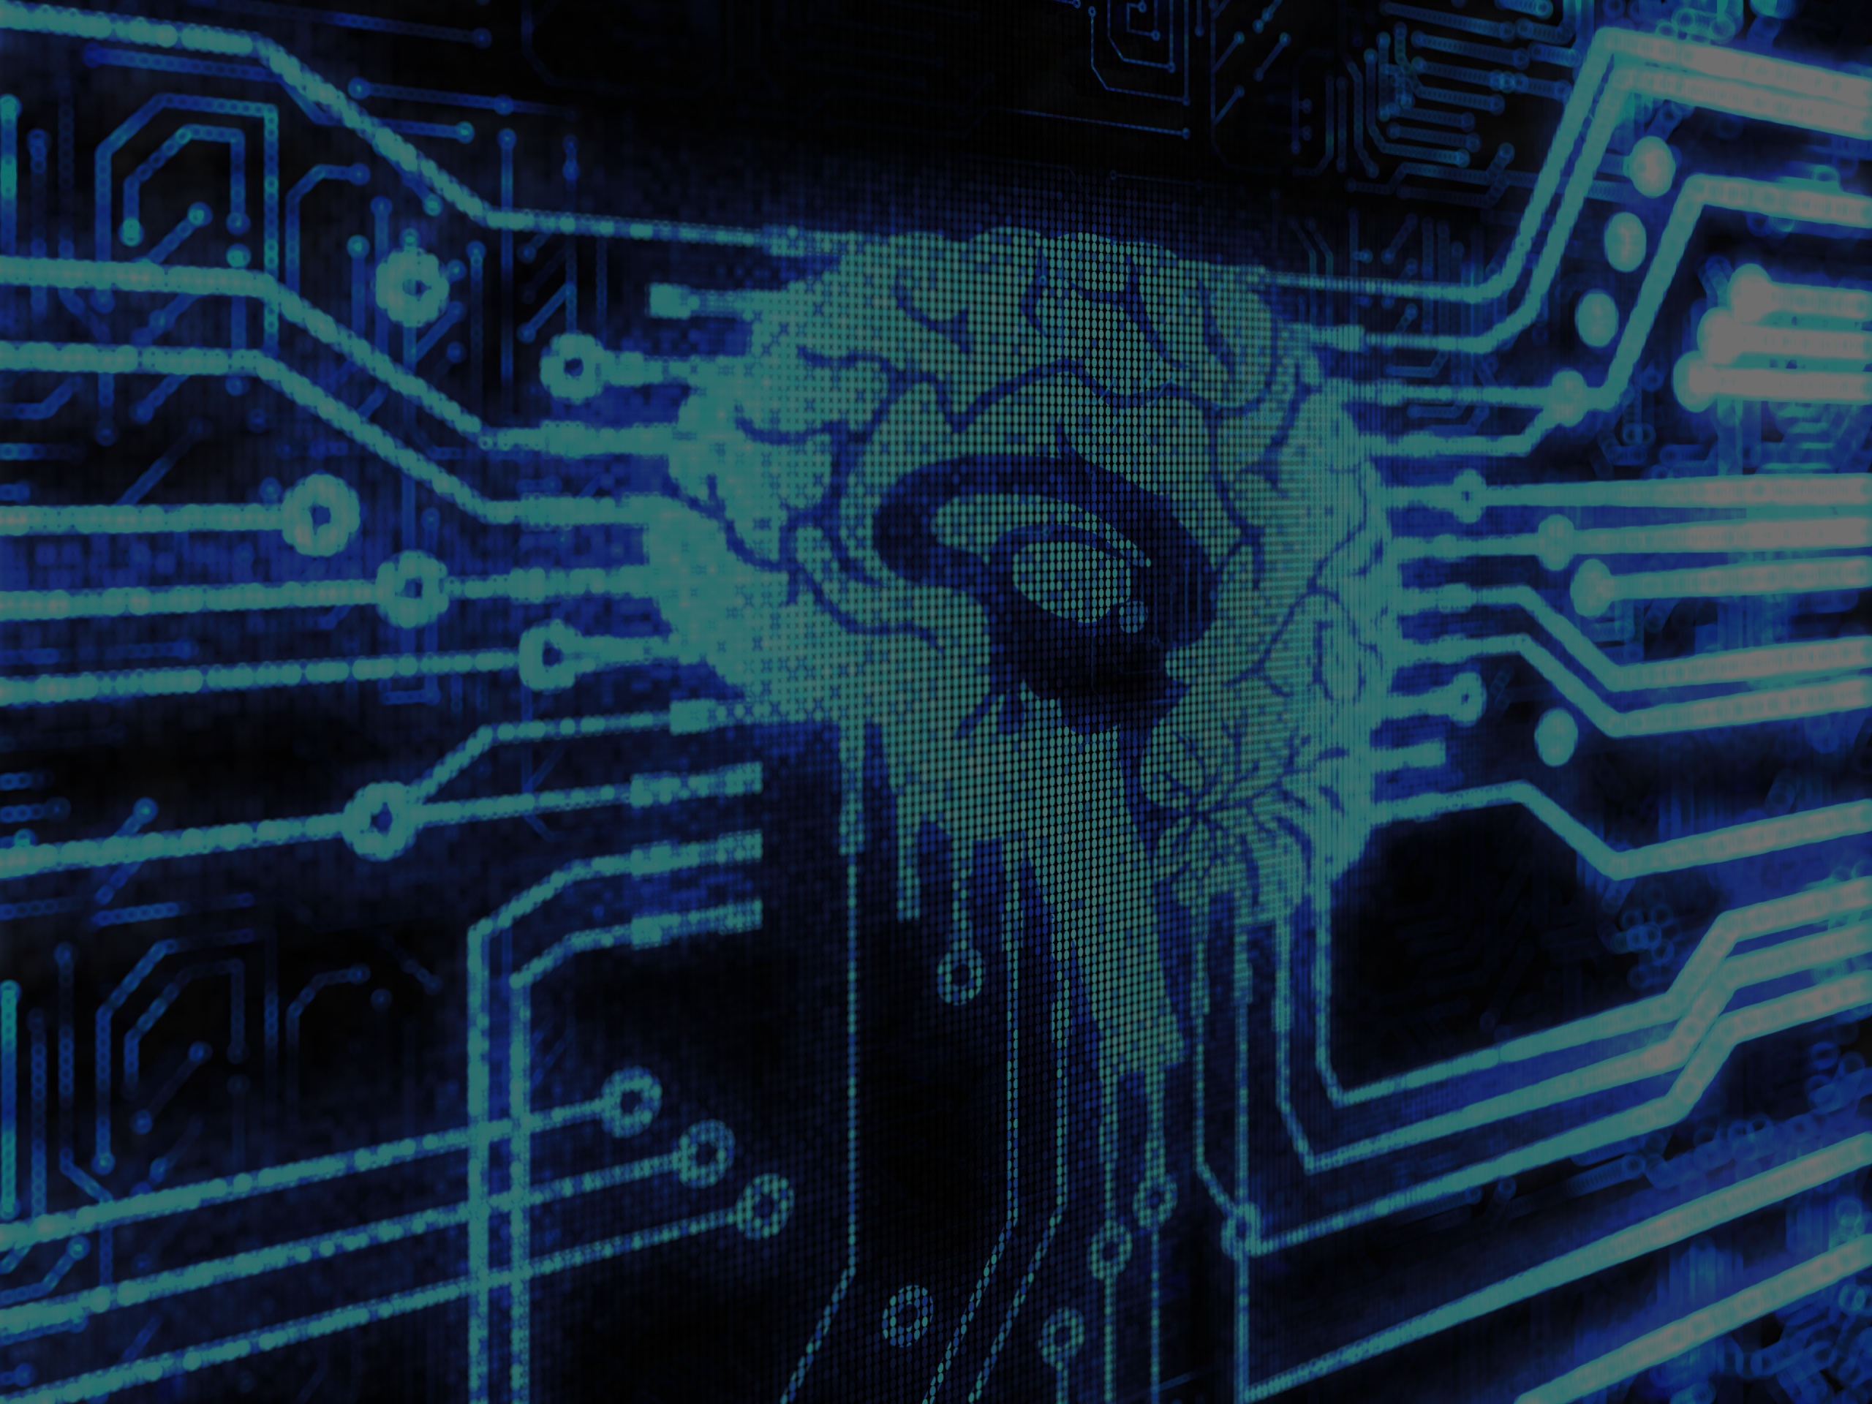
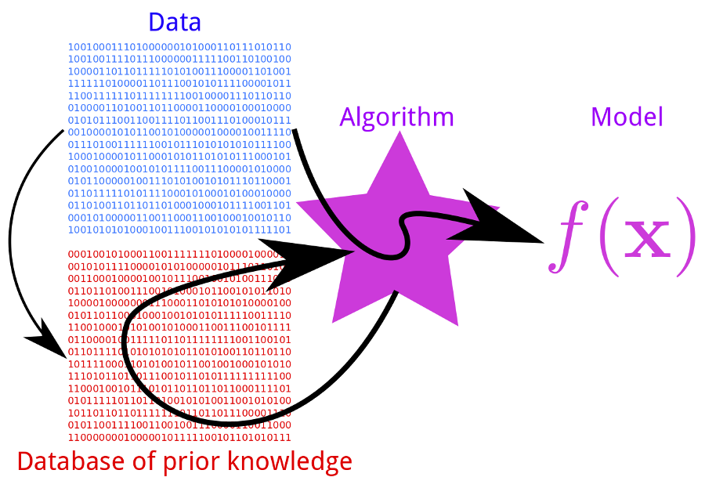
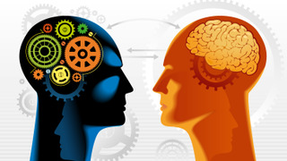

Chat-Bot with Machine Learning
A Chat-Bot which uses Machine Learning Algorithms to modify future behaviour based on past behaviour.
Features Include:
Persona integration, Memories of past conversations and user specific data like name, age, gender.
Pannous, the technology behind personal assistants like Siri. Check the weather, ask Wikipedia etc.
Instructed Learning, invalid responses can be fixed immediately by the user. Simply tell the program what to say or do instead.
Out of Band capability, able to see and call any application on the system that has been configured for use.
AIML based allowing access to a whole world of chatbots and unique personalities.
User Input
Machine Learning
History
Applying The Model
User
Open the Cargo Bay Doors HAL
Chat-Bot
I Cannot Do That Dave
User
Wrong Answer
Open the Cargo Bay Doors
Opening the Cargo Bay Doors
David Monahan
B.Eng. Computer and Electronic Engineering
Chat-Bot

